Slide 1
AKS Deployment Strategy Architect & Design
Notes:
These Learn modules are part of the AZ-204: Implement Azure App Service web apps (https://learn.microsoft.com/training/paths/create-azure-app-service-web-apps/) learning path.

Slide 2
Agenda
AKS Deployment Scenario
AKS Deployment –Options
AKS Deployment –Solutions

Slide 3
AKS Deployment Scenario
Notes:
https://learn.microsoft.com/training/modules/introduction-to-azure-app-service/

Slide 4

A Scenario for AKS Deployment
Abc Ltd , already using Azure and details is here
Application (Management Group)
Appliances (Management Group)
Desktop App (Subscription)
Customer App (Subscription)
IOT(Subscription)
Mobile(Subscription)

Slide 5


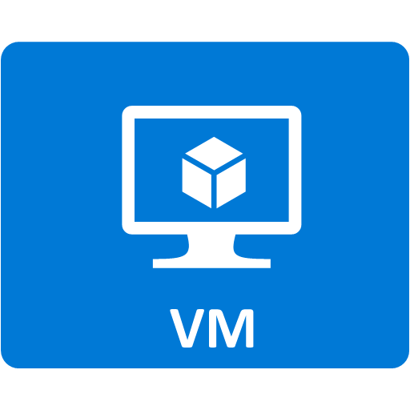


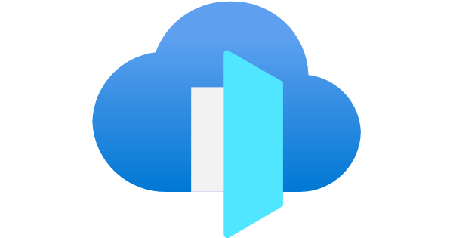
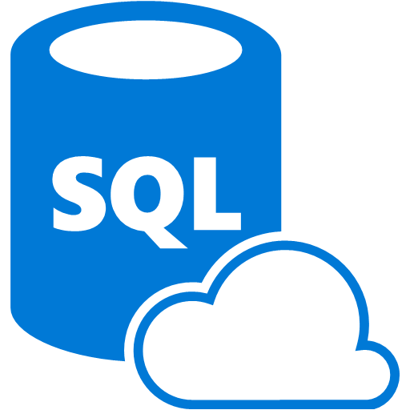

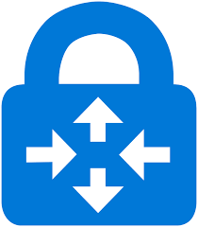
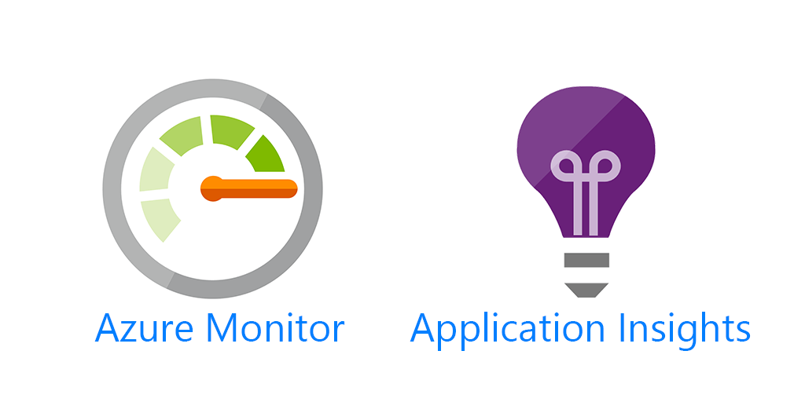

A Scenario for AKS Deployment
Abc Ltd , already using Azure and details is here
Customer App (Subscription)
Backend Subnet
App Subnet
Net-Subnet
/Product
/Service
VPN
Bastion Sub
Prod VNet
Network VNet

Slide 6
A Scenario for AKS Deployment
ABC Ltd. wants to deploy a new containerized app for three customers while adhering to the following conditions:
Infrastructure:
Utilize existing App Gateway for all customer traffic.
Minimize performance impact on App Gateway with minimal policies for container app traffic.
Isolate each customer's workload and resources from other customers.
Authorization & Access:
Separate DevOps personnel manage each customer with exclusive access rights.
Enable Container Apps to access Azure resources (Storage, SQL, Key Vault) without specifying connection details like URLs.
Network Management:
Manage network traffic for each customer separately with distinct network controls.
Monitoring & Logging:
ABC DevOps team needs separate and consolidated monitoring of each customer's infrastructure and network traffic.
Implement log analysis and alerting capabilities.

Slide 7
AKS Deployment -Options
Notes:
https://learn.microsoft.com/training/modules/introduction-to-azure-app-service/

Slide 8
AKS Deployment – Single-tenant vs Multi-tenant
A multitenant Kubernetes cluster is shared by multiple users and workloads that are commonly referred to as “tenants.”
Single Tenant Deployment:
All resources and workloads are deployed within a single AKS cluster.
Suitable for small teams or organizations with a single application or workload.
Multi-Tenant Deployment:
Multiple tenants share the same AKS cluster, with each tenant isolated within its own namespace.
Suitable for scenarios where multiple teams or departments need to deploy their applications on a shared infrastructure.
Requires careful resource management, access control, and network policies to ensure isolation and security between tenants.
Notes:
Multiple teams
This is a common use case, where different workloads from different teams within the same organization are deployed on the same cluster. Workloads can be related or independent but usually they might need to communicate with each other. In this case, team members can access the cluster with kubectl, GitOps controllers, or other tools.
Boundaries can be established by RBAC, quotas, network policies, etc. This scenario scopes a team or a workload to a namespace and it is usually referenced as Namespace as a service.
Multiple customers
The other major form of multi-tenancy frequently involves a Software-as-a-Service (SaaS) vendor running multiple instances of a workload for customers. This business model is so strongly associated with this deployment style that many people call it “SaaS tenancy.” However, a better term might be “multi-customer tenancy,” since SaaS vendors may also use other deployment models, and this deployment model can also be used outside of SaaS.
In this scenario, the customers do not have access to the cluster; Kubernetes is invisible from their perspective and is only used by the vendor to manage the workloads. Cost optimization is frequently a critical concern, and Kubernetes policies are used to ensure that the workloads are strongly isolated from each other. (Kubernetes.io)

Slide 9
AKS Deployment – Single Team vs Muti-team
Single Team Deployment:
Each development team or department has its own dedicated AKS cluster.
Provides complete isolation between teams, allowing them to manage their own cluster resources independently.
Suitable for larger organizations with multiple teams working on different projects with distinct requirements.
Multi-Team Deployment:
Multiple development teams or departments share the same AKS cluster, with each team having its own namespace.
Offers a balance between resource utilization and isolation, allowing teams to share cluster resources while maintaining some level of separation.
Requires coordination between teams for resource allocation and access control.

Slide 10
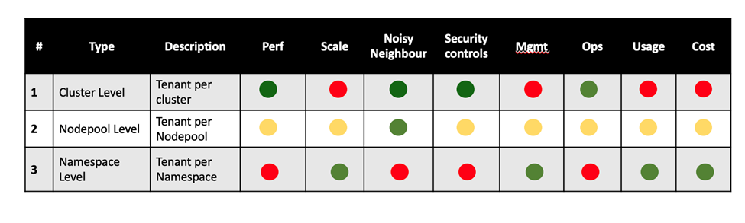
Level of Multitenancy in AKS
There are multiple levels of multitenancy that can be accomplished within AKS based on the isolation of the resources. The table below provides the classifications and depicts the benefits across different categories with green being good, amber being ok and red being bad.
Real multitenancy in AKS happens at the Nodepool and Namespace levels and requires a lot of controls at its resources level of enable this.

Slide 11
Type of Multitenancy in AKS
Let us look at the types of multitenancy based on level of isolation before getting into the different agents that could help us enable this within AKS. There are 4 different types of Multitenancy in AKS based on level of isolation .
1. Fully Shared Tenancy
2. Horizontally Partitioned Tenancy
3. Vertically Partitioned Tenancy
4. Full Isolation Tenancy
Notes:
For simplicity sake all the illustrations below have considered just the DB as only the state management layer. In enterprise applications there could be Caching Layer, Managed Disk, ESB, Unstructured Storage like Azure Blobs besides these.

Slide 12
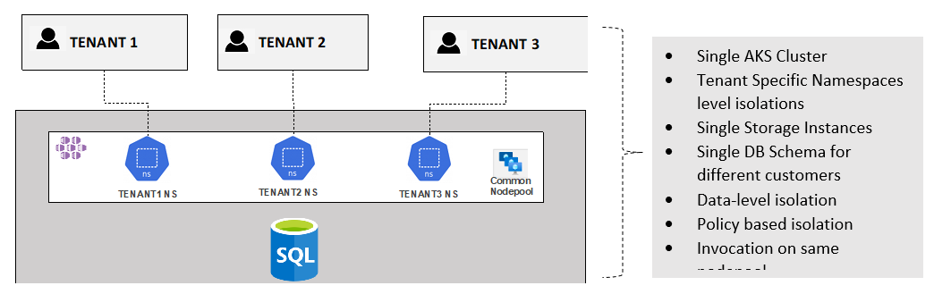
Full Shared Tenancy
Both App, Data and Infrastructure all shared.
Notes:
The following are the characteristics…
1. Single AKS Cluster resulting in lesser mgmt overheads
2. Namespace are the levels of isolations
3. Storage instances are all shared
4. Need for high levels of security posturing
5. Need for quota to reduce noisy neighbour problem
Pros:
1. Consolidation of resources and best cost optimization model
2. Brings high level of resource utilization
3. Reduces the overhead of managing multiple AKS clusters
4. With AKS and Kubernetes API brings in higher levels of scale
Cons:
1. Complex and requires a mature team to manage this ecosystem
2. Needs higher degree of skills to enforce security and isolation
3. Higher risk of noisy neighbor issue
4. This requires Infosec approval to have the data of different customers in the same DB

Slide 13
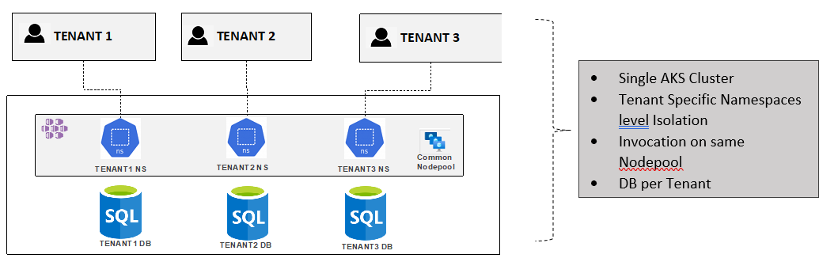
Horizontally Partitioned Tenancy
This is the most adopted model as it provides the necessary isolation at the data level yet bringing the consolidation at the App level.
Notes:
1. Single AKS Cluster
2. Namespace are the levels of isolations for Tenants from an App side
3. Data level isolation for each tenant
4. Need for high levels of security posturing for the code
5. Need for quota to reduce noisy neighbour problem
Pros:
1. Consolidation of resources at the App level while isolation at the data level
2. Brings high level of resource utilization
3. With AKS and Kubernetes API brings in higher levels of scale
4. This is an ideal model for multitenancy as the customer data is physically isolated in different DB yet there is an overall sharing of App resources
Cons:
5. Complex and requires a mature team to manage this ecosystem
6. Needs higher degree of skills to enforce security and isolation
7. Higher risk of noisy neighbour issue

Slide 14
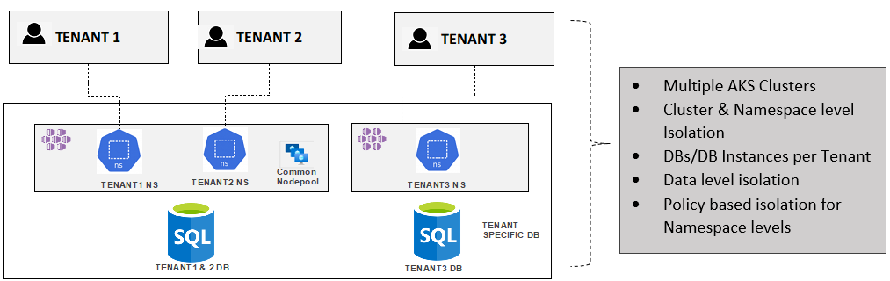
Vertically Partitioned Tenancy – Option 1
This is also frequently adopted multitenancy model where customers that don’t want to co-exist with others are managed in separate clusters and DB instances. This provides the maximum isolation at the data and App levels for such cases
Notes:
1. More than one AKS Clusters depending on the demands of the customer for isolation
2. Cluster and Namespaces levels of isolations for Tenants from an App side
3. DB Instance and Database level isolation for data for tenants depending on the needs
4. Need for high levels of security posturing and quota for reducing noisy neighbours for namespace level isolations
5. Significant overhead to management as there are multiple clusters.
Pros:
1. Higher levels of isolation results in better performance and reduced noisy neighbour issue
2. Easier to setup and operate as there security postering and policy need not be so complex
3. This is an ideal model for customer data that demand physically separate code and data
Cons:
1. Higher cost due to multiple clusters
2. Higher management overheads eventhough operating can be easy

Slide 15
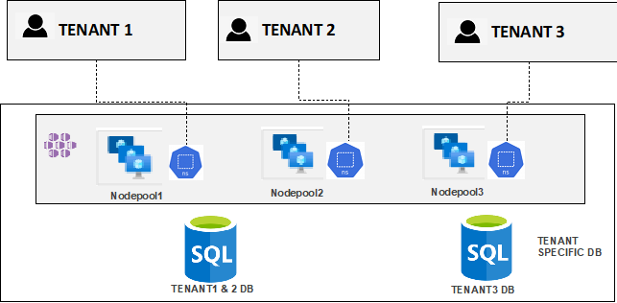
Vertically Partitioned Tenancy – Option 2
Alternative Vertical Partitioned Model for reducing management overhead with single cluster and dedicated nodepools.
Notes:
1. More than one AKS Clusters depending on the demands of the customer for isolation
2. Cluster and Namespaces levels of isolations for Tenants from an App side
3. DB Instance and Database level isolation for data for tenants depending on the needs
4. Need for high levels of security posturing and quota for reducing noisy neighbours for namespace level isolations
5. Significant overhead to management as there are multiple clusters.
Pros:
1. Higher levels of isolation results in better performance and reduced noisy neighbour issue
2. Easier to setup and operate as there security postering and policy need not be so complex
3. This is an ideal model for customer data that demand physically separate code and data
Cons:
1. Higher cost due to multiple clusters
2. Higher management overheads eventhough operating can be easy

Slide 16
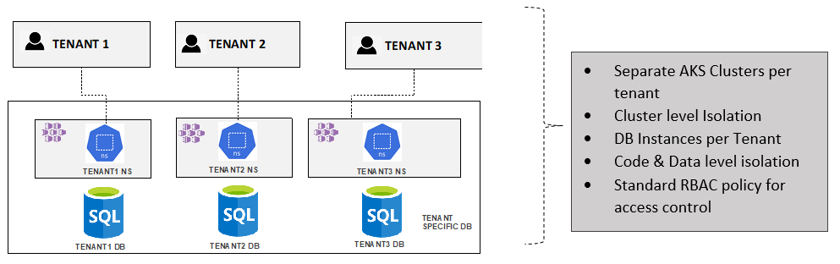
Full Isolation Tenancy
This is technically not a multitenant model but more an multi-instance model.
This could have the highest cost and management overheads but provides greatest levels of security due to the isolation. There is no noisy neighbour issues and predominantly the impact of one tenant does not affect the others.

Slide 17
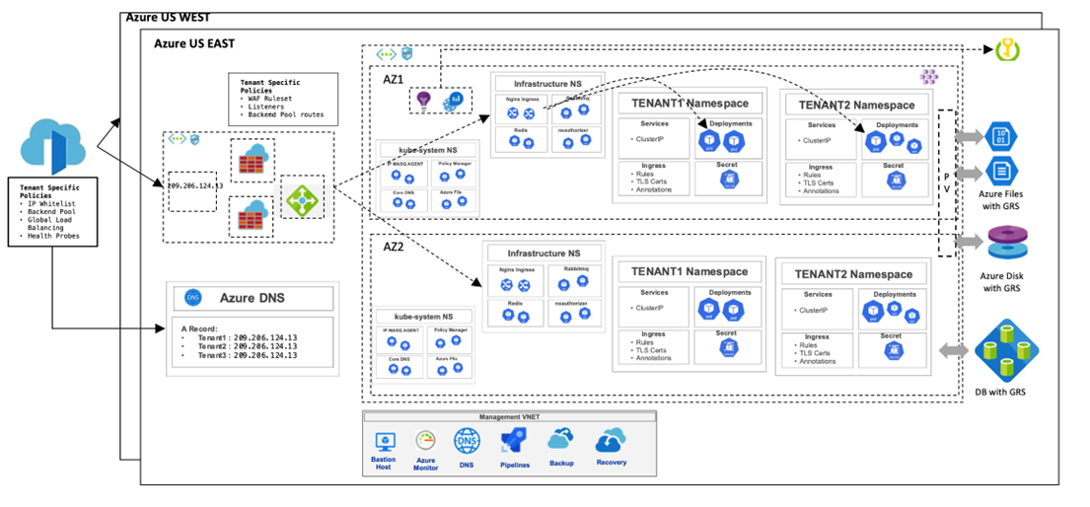
Multitenancy Big Picture
Notes:
There more configurations to be done from multitenancy perspective outside of the AKS platform not limited to, for successful implementation.
• Azure DNS A Record configuration for each tenant
• Front Door profiles based on tenants
• API Gateway/LB backend configurations
• CI/CD pipeline setup
• Azure Key Vault workspaces
• Azure Monitor workspace
• Azure AD Tenancy and strategy for scale

Slide 18
AKS Deployment -Solutions
Notes:
https://learn.microsoft.com/training/modules/introduction-to-azure-app-service/

Slide 19


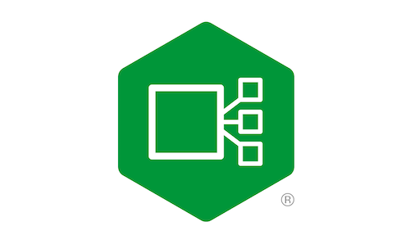

Proposed Deployment.
Abc Ltd , already using Azure and details is here
Customer App (Subscription)
Network VNet
Web App Traffic
Backend Subnet
App Subnet
Net-Subnet
Container
App Traffic
/Product
/Service
Prod VNet
VPN
Bastion Sub
AKS Subnet
Ingress Controller
Customer1NS
Customer2NS
Namespace
Kube-System
Customer3NS
AKS VNet

Slide 20
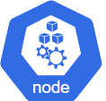
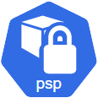
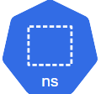






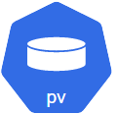
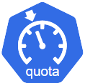

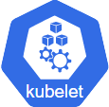






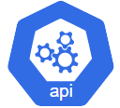
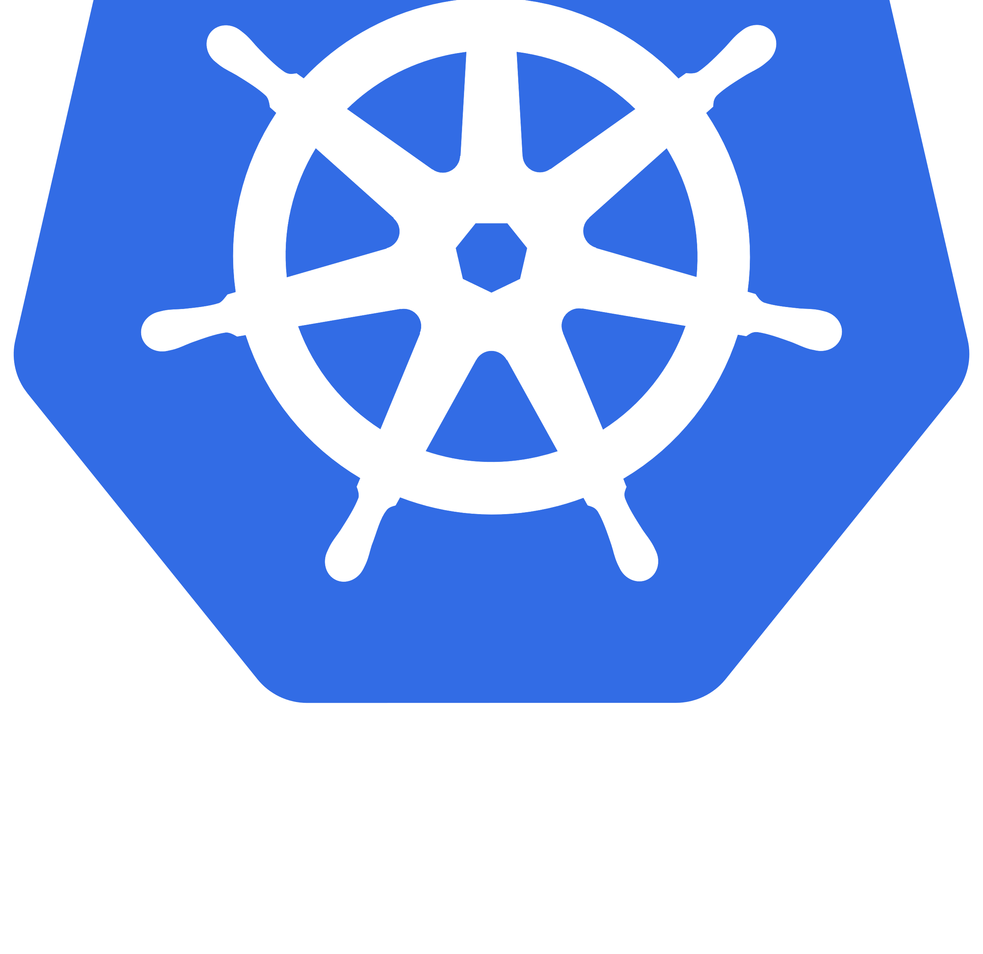


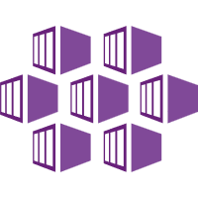

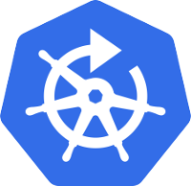










Calcio
KubeNet
Namespace : Kube-System
Namespace 1
https://appexternal.xyz.com
External
Applications
App Gateway
Internal Load Balancer
Nginx Ingress Controller
https://appinternal.xyz.eg
Internal
Applications
Kubernetes API server
Master – Azure Managed
Namespace 2
Kubernetes
Cluster
1
RBAC
Azure Kubernetes
Service
.
On-Premise
Kured
Namespace N
Subnet
2
Virtual Network
Namespace User
Developer
Namespace Admin Cluster Admin
Log
Analytics
AAD
Prometheus + Grafana (KubeCost)
Monitor
Azure Key Vault
Azure
Notes:
Menion- kubenet , calico n/w policy, POD ip allocation, Integrated Vnet(custom VNet) and Enable Virtual Nodes(capacity planning) – Subnet cannot be expanded but Vnet can be, CIA(confidentiality), Data Privacy(high sec), Preprod- how many cluster we will run ?, On Premise Connectivity(FCR) – whether we will give subnet access completely(can we have PROXY ),

Slide 21
End of presentation

